Slide 1
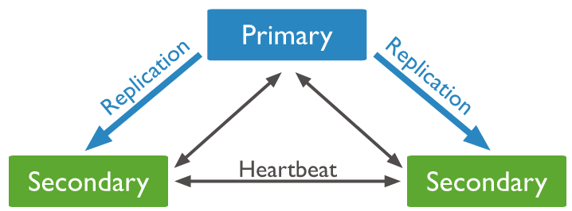
Understanding Arbiter and Heartbeat

Slide 2

Understanding Arbiter and Heartbeat
Primary
Secondary
Secondary
Secondary
Add a mongod instance to a replica set as an arbiter. An arbiter participates in elections but does not hold data (i.e. does not provide data redundancy)

